Slide 1
Product analyst Assessment
By
Nishanth Chintamani

Slide 2

Data Statistics
59K Accounts
29K applied at Branch and 29K applied at Dealer
11K members with co- borrower
FICO range 850 (Excellent) to 550 (Bad)
14K New vehicles and 44K Used vehicles
Write-Off accounts 587

Slide 3
Project Objective
Financial analysis
Market impact
Member impact
Analyze all the possible cases where company is loosing money and experiencing losses.
Identify the accounts which do not produce any values and the accounts which will yield higher profits in the future.
Anayze different points where the customer/ members stands profitable by associating with this company.

Slide 4
New Variable
Numbers of years as a member (Present Date - Member Since)
Loan maturity period (Maturity Date – Funded Date)
Fund to income percent (Funded amount % Yearly Income)

Slide 5
Important Correlations
 | Co-Borrower | Current Balance | Delinquent: | FICO | Funded Amount | Interest Rate: | Member Yearly Salary | Vehicle Value: | Write-Offs
Co-Borrower | 1.00 | 0.00 | -0.06 | 0.00 | 0.00 | 0.25 | 0.00 | 0.00 | -0.04
Current Balance | 0.00 | 1.00 | 0.11 | -0.02 | 0.56 | -0.03 | 0.45 | 0.52 | 0.02
Delinquent: | -0.06 | 0.11 | 1.00 | 0.20 | -0.04 | -0.16 | 0.07 | 0.01 | 0.34
FICO | 0.00 | -0.02 | 0.20 | 1.00 | -0.01 | -0.56 | -0.01 | -0.01 | 0.13
Funded Amount | 0.00 | 0.56 | -0.04 | -0.01 | 1.00 | -0.08 | 0.79 | 0.92 | -0.03
Interest Rate: | 0.25 | -0.03 | -0.16 | -0.56 | -0.08 | 1.00 | -0.15 | -0.18 | -0.11
Member Yearly Salary | 0.00 | 0.45 | 0.07 | -0.01 | 0.79 | -0.15 | 1.00 | 0.85 | 0.04
Vehicle Value: | 0.00 | 0.52 | 0.01 | -0.01 | 0.92 | -0.18 | 0.85 | 1.00 | 0.00
Write-Offs | -0.04 | 0.02 | 0.34 | 0.13 | -0.03 | -0.11 | 0.04 | 0.00 | 1.00

Slide 6
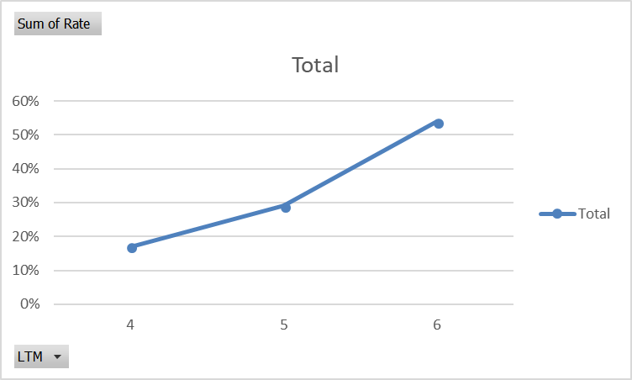
Loan to maturity period
Loan to maturity period (years) | % of delinquency
4 | 17%
5 | 29%
6 | 54%
More number of years, increases the chance of delinquency

Slide 7
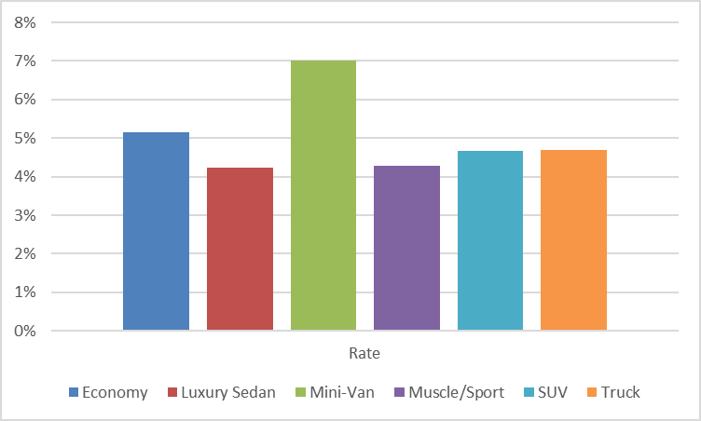
Vehicle Type Vs. Delinquent
Vehicle Type | Delinquent Rate
Economy | 5%
Luxury Sedan | 4%
Mini-Van | 7%
Muscle/Sport | 4%
SUV | 5%
Truck | 5%
Highest delinquency rate is for Mini-Van

Slide 8
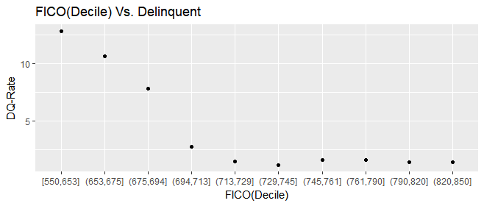
FICO decile Vs. Delinquent Rate
FICO decile z | Delinquent | Listings Count | Delinquent Rate
(550,653) | 758 | 5899 | 12.8
(653,675) | 641 | 6014 | 10.66
(675,694) | 461 | 5869 | 7.85
(694,713) | 164 | 5920 | 2.7
(713,729) | 84 | 5713 | 1.47
(729,745) | 69 | 6120 | 1.1
(745,761) | 91 | 5830 | 1.56
(761,790) | 90 | 5782 | 1.
(790,820) | 83 | 5852 | 1.42
(820,850) | 83 | 5829 | 1.4
FICO score in the range (550, 653) are most likely to fall under delinquent category

Slide 9
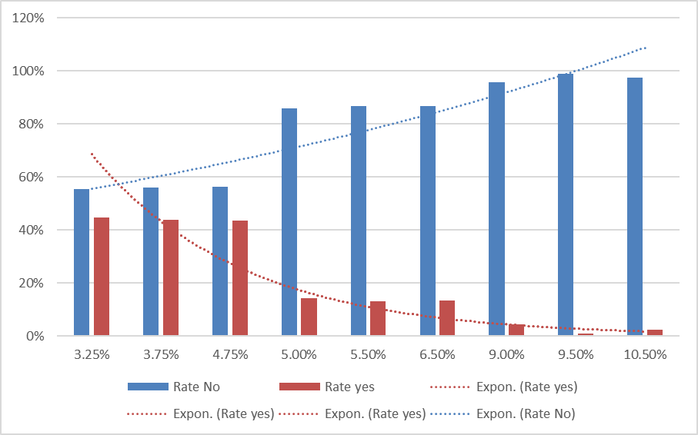
Co-Borrower Vs. Interest Rate
Interest Rate | Without co- Borrowers | With co-Borrowers
3.25% | 55% | 45%
3.75% | 56% | 44%
4.75% | 56% | 44%
5.00% | 86% | 14%
5.50% | 87% | 13%
6.50% | 87% | 13%
9.00% | 96% | 4%
9.50% | 99% | 1%
10.50% | 97% | 3%
Members with Co-Borrowers are having less interest rates

Slide 10
Quantifying Dependencies
According to Information Value test the most significant numerical variables related delinquency :
According to χ2 test the most significant categorical variables related delinquency :
FICO | FTI | % of balance remaining | Interest Rate | Current Balance | Vehicle Value | Yearly Salary | Funded Amount | Vehicle Year | Loan Maturity Period | Member Years | Age
0.949413 | 0.9091982 | 0.7089242 | 0.6540806 | 0.4164571 | 0.2313054 | 0.21821 | 0.2115688 | 0.2039589 | 0.1371318 | 0.0756069 | 0.0390566
Co- Borrower
New/ Used Vehicle
Vehicle Type

Slide 11
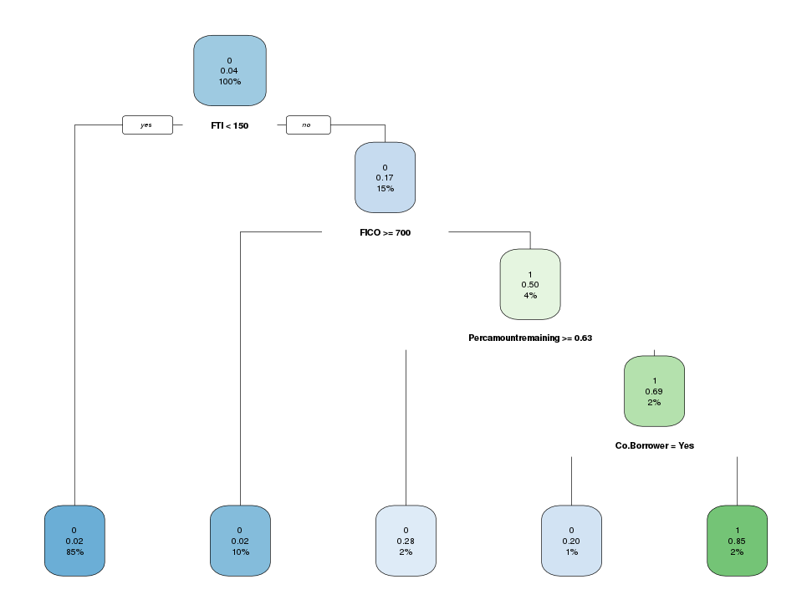
Model: Classifications
From Classification model, even though company is giving high interest rate with less FICO score – it is not compensating the losses caused by Delinquencies and write- offs.
FICO < 700 delinquency percent is 2x more than that of FICO > 700
Company is incurring maximum loss by funding amount over the member annual income.

Slide 12
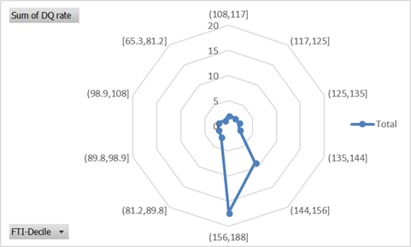
Funded amount to income ratio (FTI)
FTI-Decile (%) | Delinquency | Count | Delinquency rate
(65.3,81.2) | 81 | 5901 | 1.37
(81.2,89.8) | 155 | 5890 | 2.63
(89.8,98.9) | 129 | 5874 | 2.2
(98.9,108) | 127 | 5920 | 2.15
(108,117) | 124 | 5845 | 2.12
(117,125) | 115 | 5886 | 1.95
(125,135) | 123 | 5869 | 2.1
(135,144) | 130 | 5887 | 2.21
(144,156) | 529 | 5881 | 9
The company is taking risk by over lending the fund which they can pay off, there by more chance of Delinquency

Slide 13
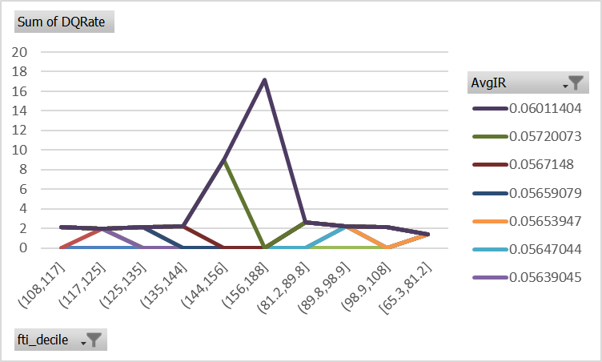
Solution
Need to stop lending amount over the members repaying capacity
Graph: FTI Decile Vs. % Avg Interest with respect to delinquency rate

Slide 14
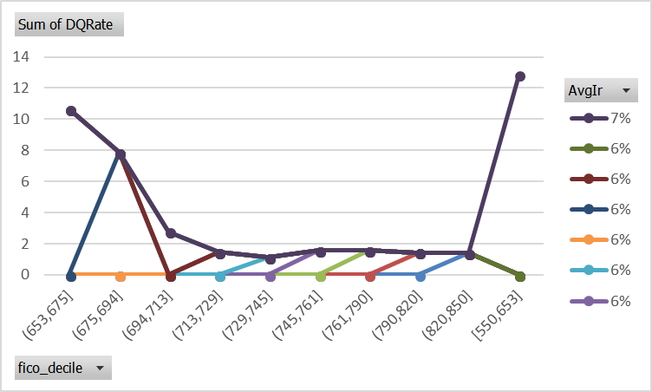
Solution (cont.)
Should increase the interest rate for members with FICO score ranging from 550 to 694 by atheist two times.
DQ rate [FICO(550:694)] = 2.48*{DQ rate [FICO(550:694)]}
Graph: FICO Decile Vs. % Avg Interest with respect to delinquency rate

Slide 15
Data Analysis Is performed using
R programming
MS Excel
Rapid Miner
Tableau

Slide 16


THANK YOU
Nishanth Chintamani
+1 816 248 9807
nishanth.chintamani95@gmail.com

